Slide 1

Stock Portfolio Optimization and Regression Analysis
Steve Walters
Springboard Capstone Project 3
April 2024

Slide 2
The Problem
Problem Statement:
What’s the best allocation of assets within a portfolio? This project aims to answer that question by creating models that optimize portfolios based on annual return or risk.
Having data-driven methods for optimizing the allocation of stocks or other assets in a portfolio can be applied in many use cases, for a broad section of investors, from individuals to portfolio managers, to fund managers.
Once we have optimized a sample portfolio of ten randomly selected stocks we will then look to validate the results and determine the most effective portfolio optimization method through the use of lagged regression models.
Finally we compare the historical results with forward-looking results to see if the model has predictive power.

Slide 3
GOALS
Determine the best optimization model from a choice of Efficient Frontier, Black-Litterman, and Hierarchical Risk Parity.
Using the identified optimal portfolio, conduct lagging regression analysis to determine whether stock allocations in a portfolio might have a statistical relationship with the returns and volatility of the portfolio.
Compare the results from the historical data with forward-looking data to see whether the optimized portfolio is performing better than a benchmark portfolio – in this case the S&P 500.

Slide 4

Sourcing and Loading the Data

Slide 5
Sourcing the Data
Two datasets used
A csv with S&P 500 constituents from Github
Downloaded historical data (since 1/1/2019) from Yahoo!Finance for all the S&P 500 stocks.

Slide 6
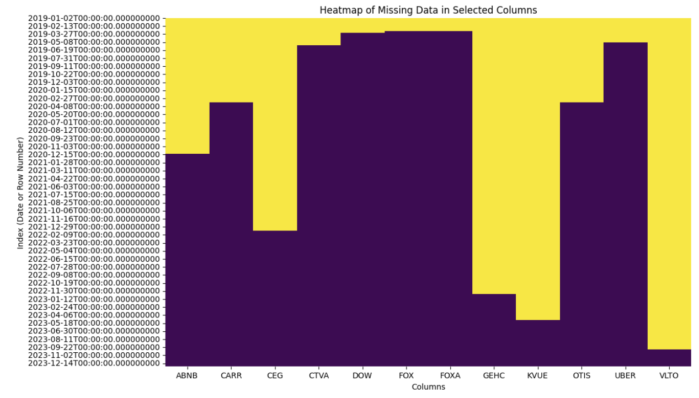
Loading the Data
The constituents csv file was used to provide the list of stock symbols for download.
The yfinance library was used to perform the downloads.
The resulting dataframe was then cleaned, removing the tickers that did not download due to delisting or other issues.
A dozen tickers were identified as missing data due to being added to the S&P 500 after 1/1/2019. These were excluded from being used in the creation of the portfolio used for modeling

Slide 7

Exploratory Data Analysis

Slide 8
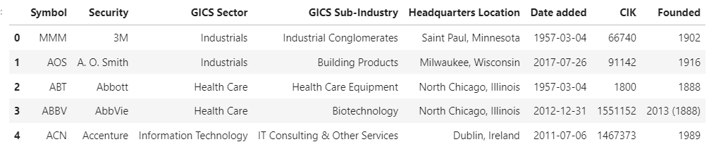
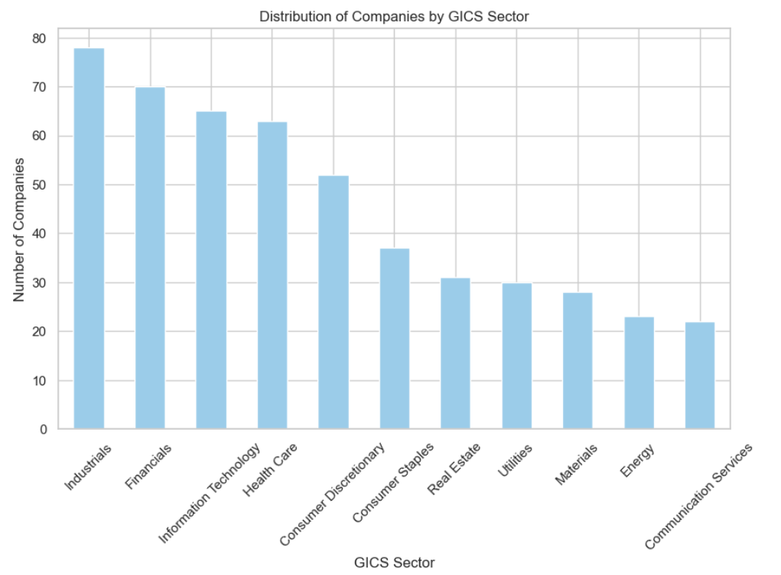
GICS Sector Features Exploration of the S&P 500 dataframe to see what features are available besides the time series.

Slide 9
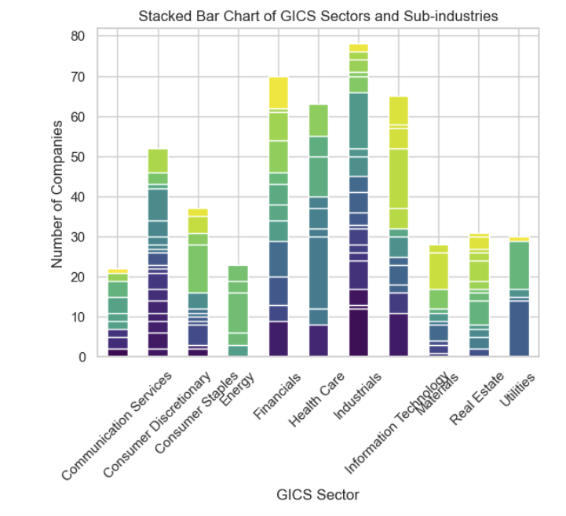
GICS Industry Sub-Sectors
An exploration of the industrial subsectors was conducted and it was determined there were too many to consider in this analysis

Slide 10
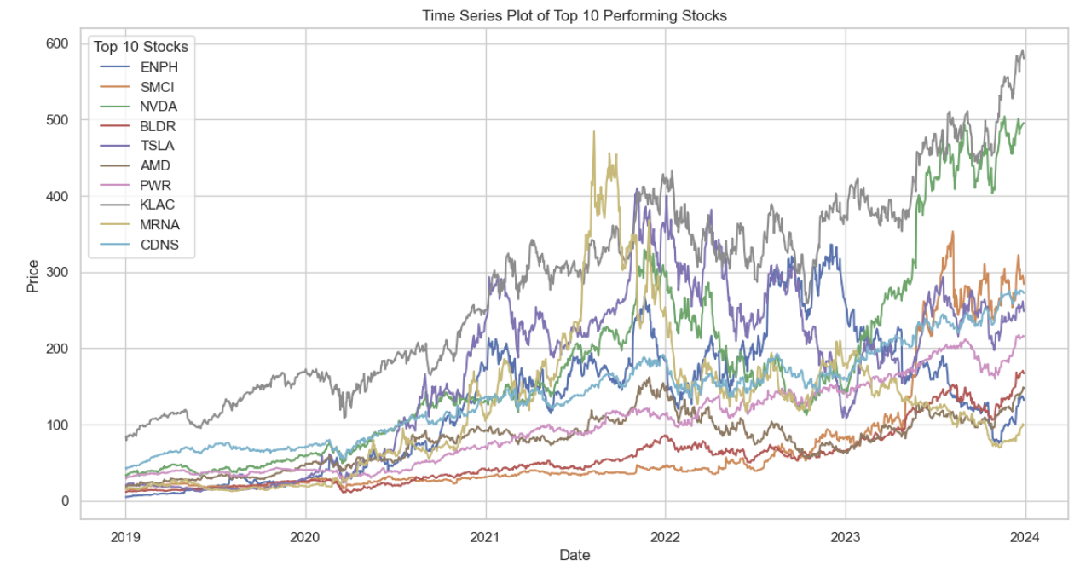
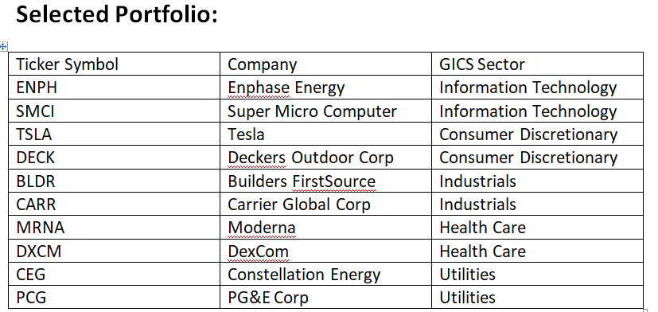
Top Performing Stocks
Because we want to maximize the expected return these are some of the top choices for inclusion in the portfolio. Below is the actual portfolio, which limits selection to no more than two stocks from any one GICS sector.

Slide 11

Portfolio Modeling

Slide 12
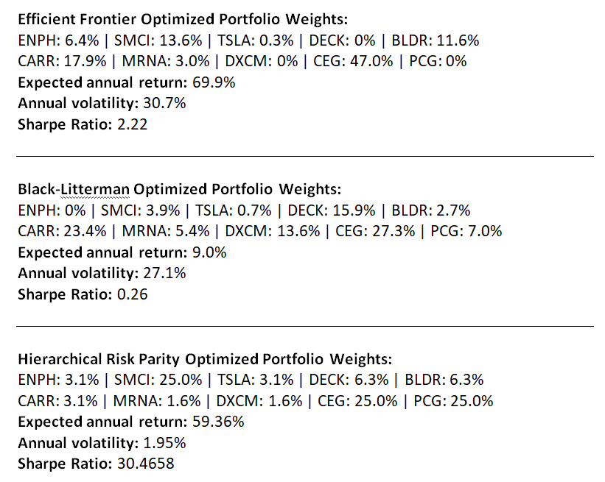
Optimized Portfolios
Three different portfolio optimization methods were used to maximize return and Sharpe ratio, while minimizing volatility. Stock weightings varied greatly between the models, with the Hierarchical Risk Parity Model delivering the best results by far.

Slide 13

Preprocessing, Training and Modeling

Slide 14
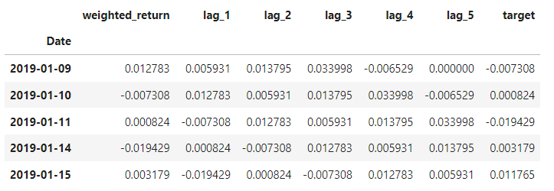
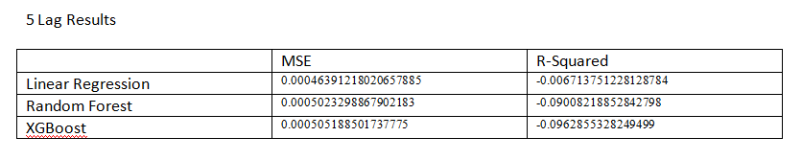
Model Selection and Evaluation
We transformed our forecasting problem into a regression problem by using lagging in three models – Linear Regression, Random Forest, and XGBoost. A 5 period lag was used for the initial modeling.
Upon application, the Linear Regression model achieved an MSE of 0.000464 and an R² score of -0.0067 on the test data. While the R² score was slightly negative, indicating that the model predictions did not surpass the baseline’s explanatory power by a wide margin, the low MSE pointed to high predictive accuracy in terms of the magnitude of errors. This suggests that while the model's predictions are close to actual values, improving explanatory power could be a focus for further model refinement.

Slide 15
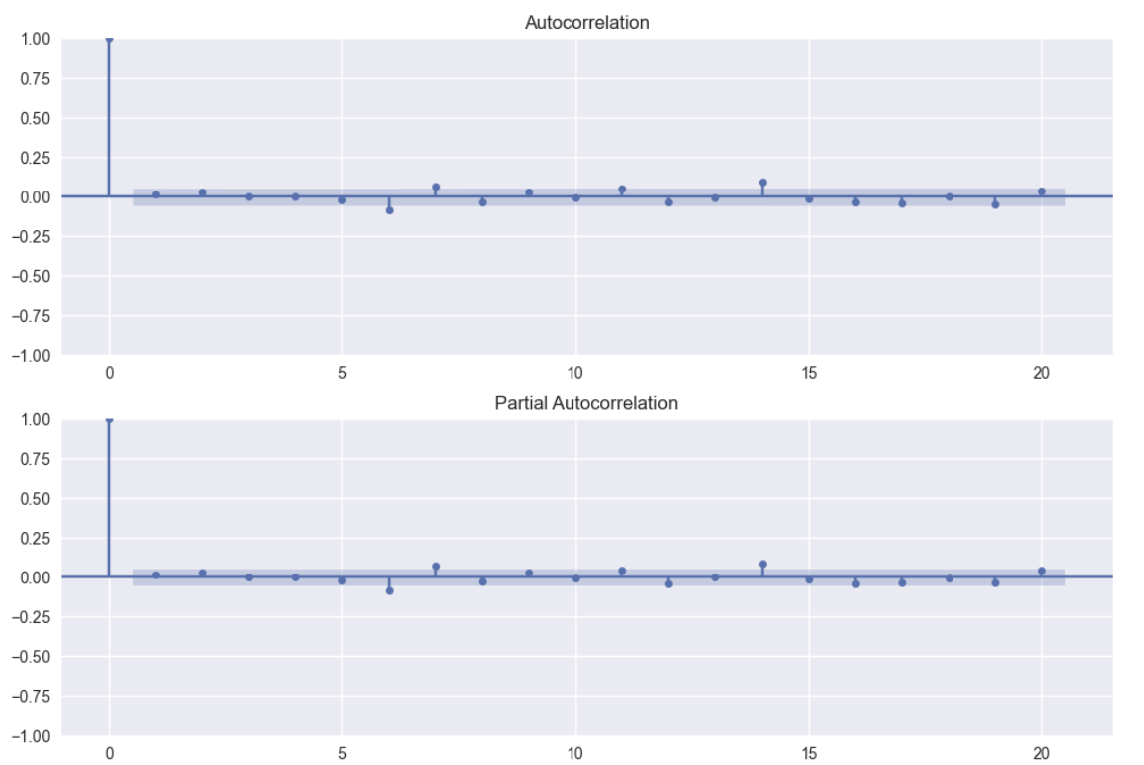
Model Refinement
Now that we had initial results we looked to refine and improving performance through finding the optimal lag for the Linear Regression model. This was done by identifying statistically significant lags using Autocorrelation Function (ACF) and Partial Autocorrelation Function (PACF).
Spikes outside the blue shaded confidence interval indicate lags that are significantly correlated with the target. In the plots above the best result is 14 lags, which were then implemented in the models. After implementing the 14 lags I found that the results for the linear regression model showed the greatest improvement. With that in mind I decided to explore both Ridge and Lasso to address potential multicollinearity or overfitting.

Slide 16
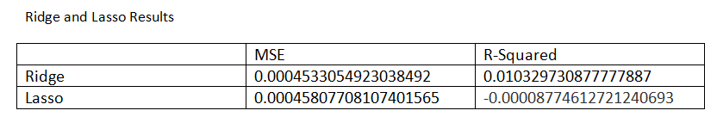
Ridge and Lasso Results
How did the refinements perform?
In terms of Adjusted R-Squared and Mean Squared Error
Ridge Regression:
MSE: 0.000453, which is slightly better than the basic linear regression (0.000449).
R² Score: 0.0103, positive and improved compared to the basic linear model (0.0178). This suggests that Ridge regression slightly improved the fit of the model, but the change is not substantial.
Lasso Regression:
MSE: 0.000458, which is also slightly higher than the linear regression's MSE but lower than XGBoost's.
R² Score: -0.0000877, which is nearly zero, indicating that the model's predictions are almost equivalent to predicting the mean of the target variable. This might suggest that the Lasso penalty was too strong, leading to an underfitting model.

Slide 17
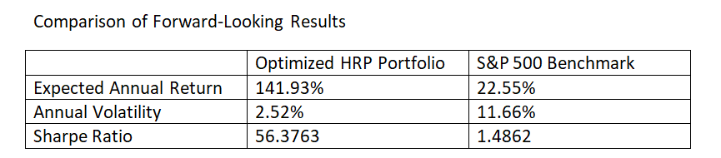
Comparison with Forward Data
As a final test of the optimized portfolio I compared the results on historical data (1/1/2019 through 1/1/2024) with the actual results of the optimized portfolio when applied to forward data (1/2/2024 through 4/24/2024)
The HRP-based portfolio demonstrated superior risk-adjusted returns compared to traditional methods during the historical period. Forward-looking analysis against the S&P 500 using data from 2024 was also performed and showed promising results.

Slide 18

Conclusion

Slide 19
The analysis confirmed the effectiveness of the HRP method in constructing a well-diversified portfolio that outperforms traditional models in terms of Sharpe ratio and overall risk management. The combination of the results from a 14 period lagged linear regression model and the actual comparison of forward looking results using the HRP optimized portfolio indicates some promise in the predictive power of the model. In the forward-looking analysis the HRP optimization outperformed the S&P 500 by more than 6x, while also reducing volatility and greatly increasing the Sharpe Ratio.
Future Work:
Further research could explore deeper integration with machine learning techniques to refine asset selection and weight allocation. The model could also be modified to allow for user input of custom portfolios and regular updates to portfolio weights.

Slide 20
Fin

